Slide 1
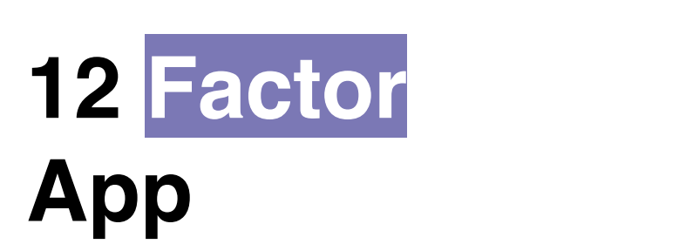
Presented By
Munieswaran.N

Slide 2
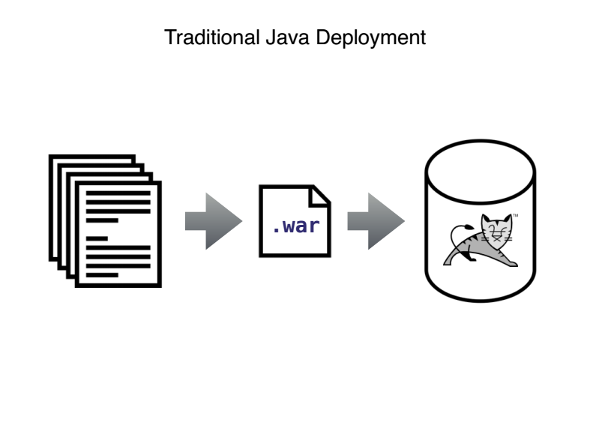

Slide 3
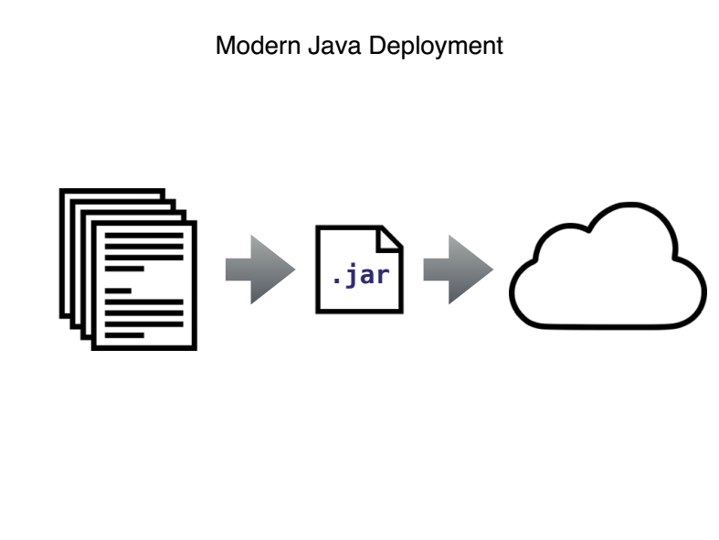

Slide 4
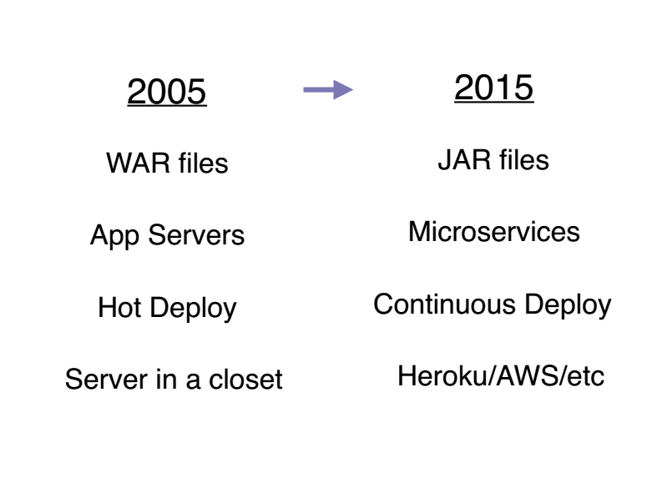

Slide 5
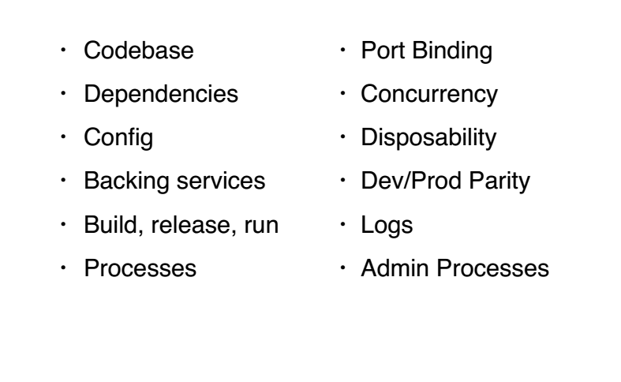
12 Factors Principles

Slide 6
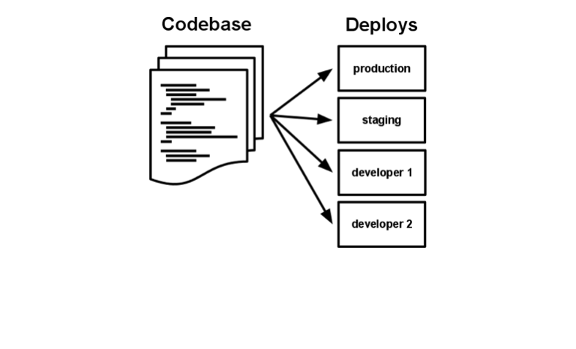
1. CODE BASE

Slide 7
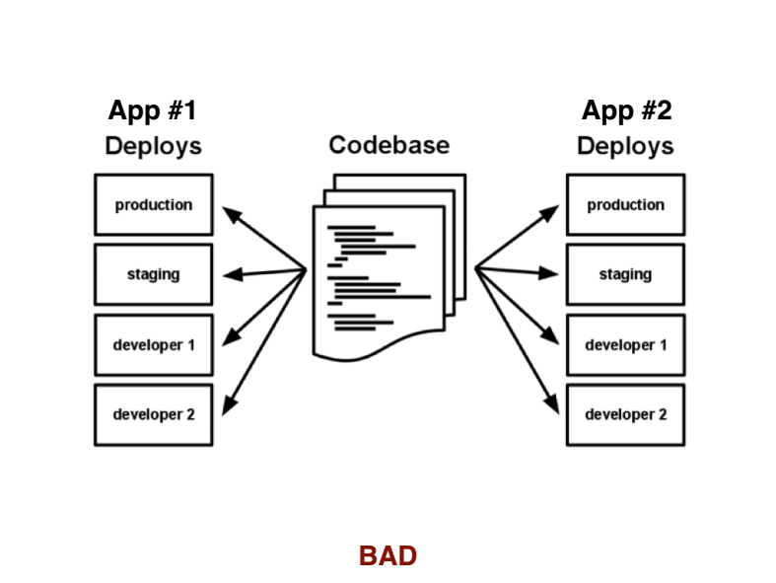

Slide 8


Slide 9
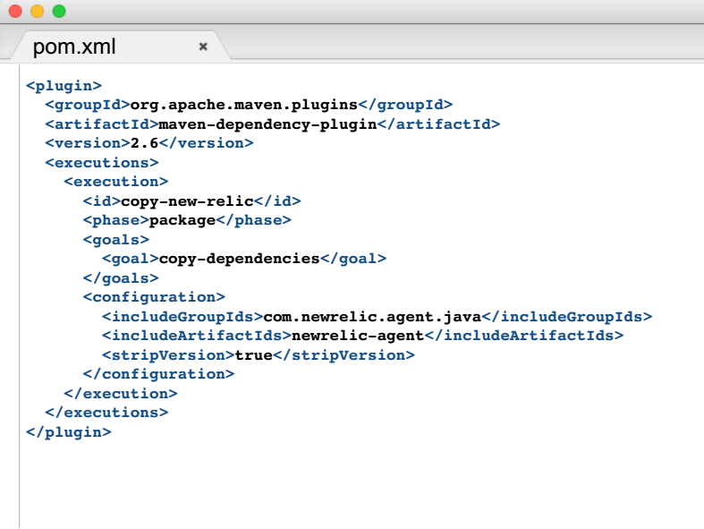
2.Dependency

Slide 10
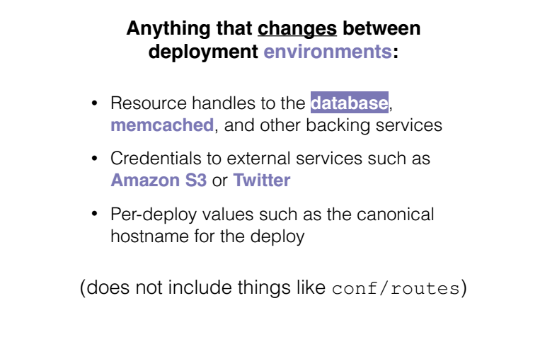
3.Configuration

Slide 11
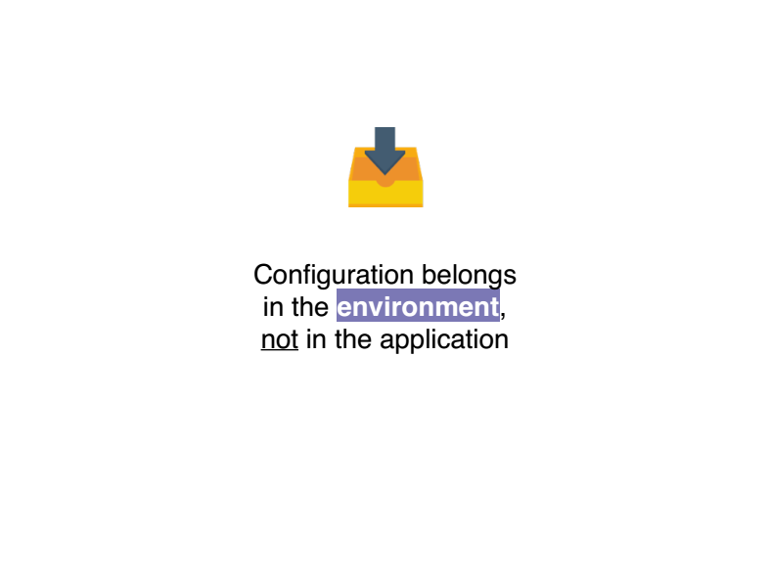

Slide 12
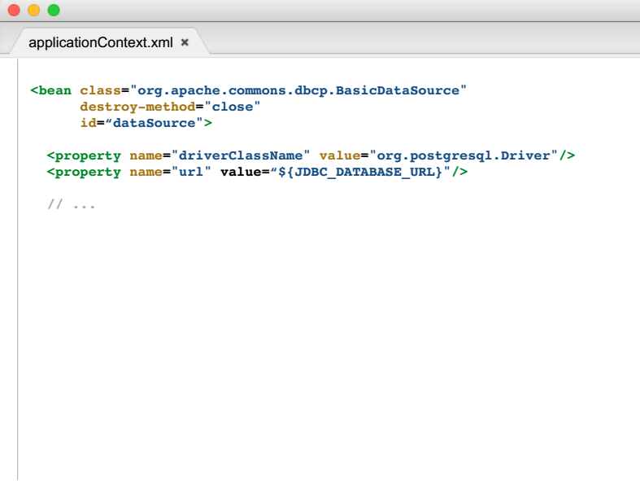
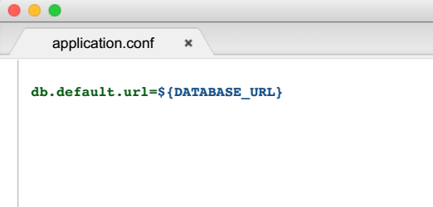

Slide 13
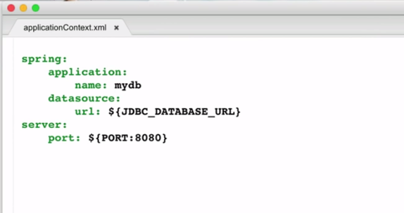

Slide 14
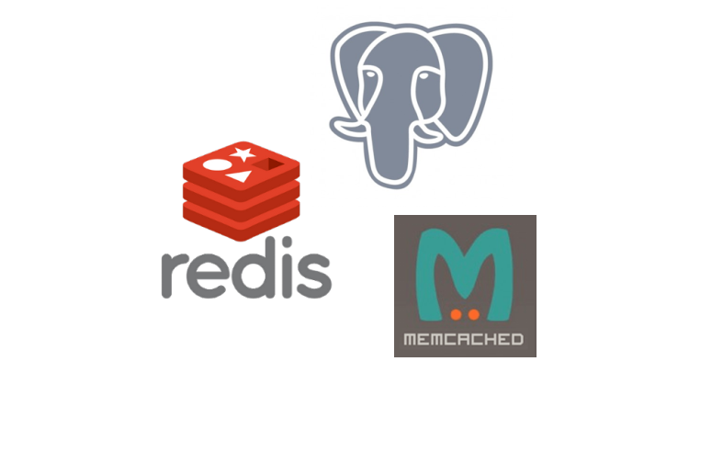
5.BACKING SERVICES

Slide 15
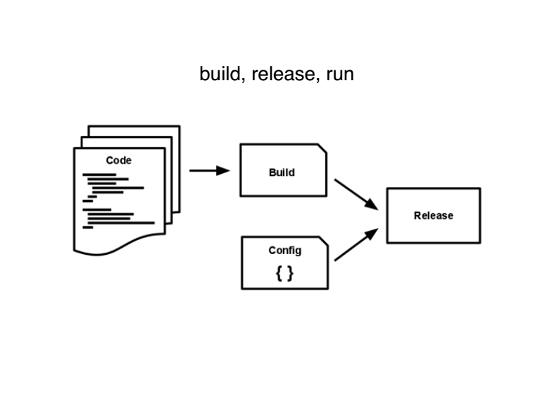

Slide 16
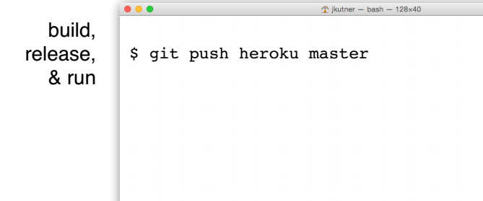
Build$mvn clean install
Relase -$mvn heroku:deploy
Run - $java –jar myapp.war

Slide 17
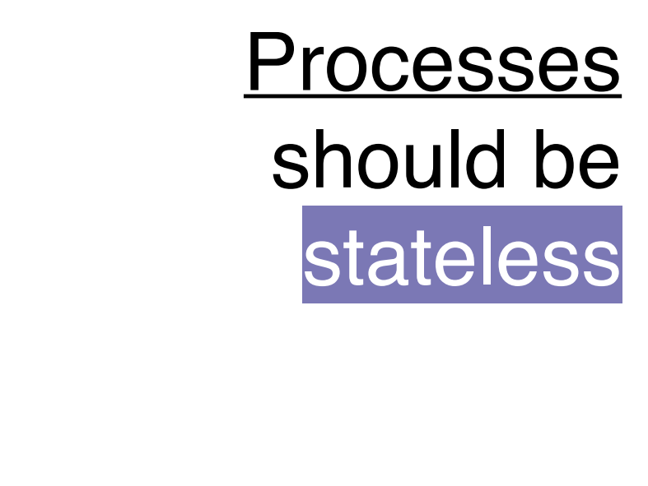

Slide 18
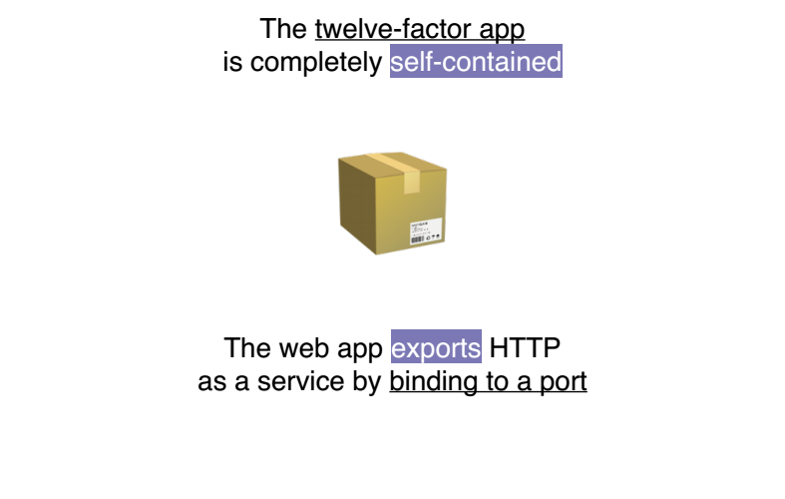
Port Mapping

Slide 19
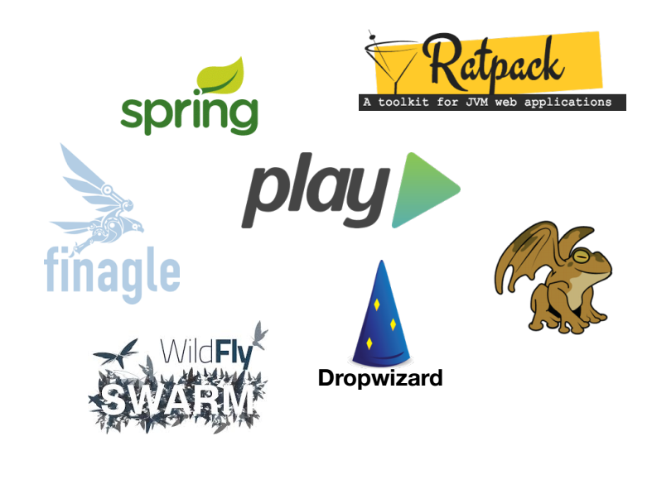

Slide 20
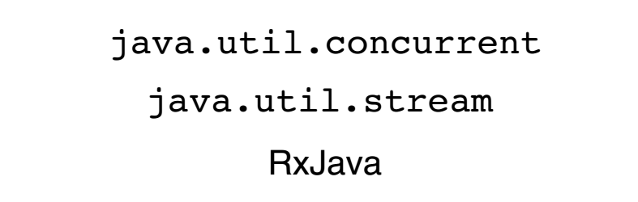
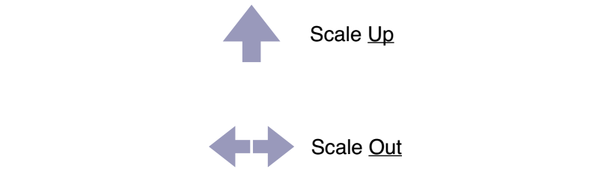
Concurrency

Slide 21
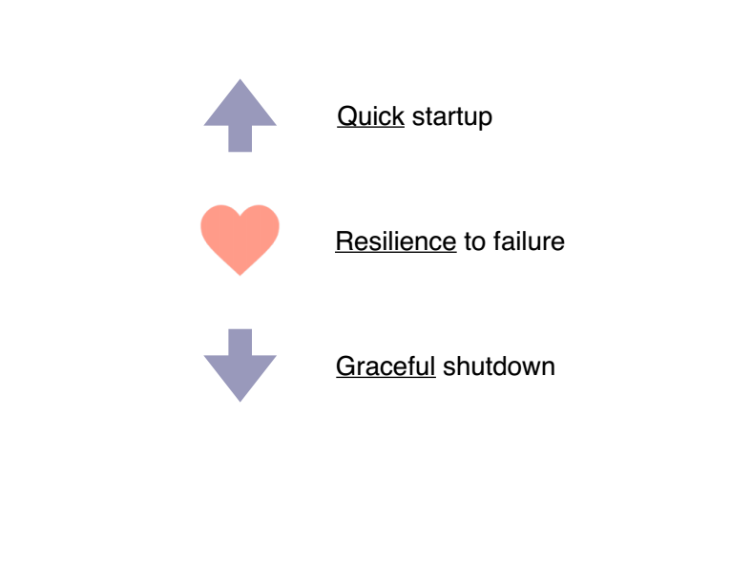
Disposability

Slide 22
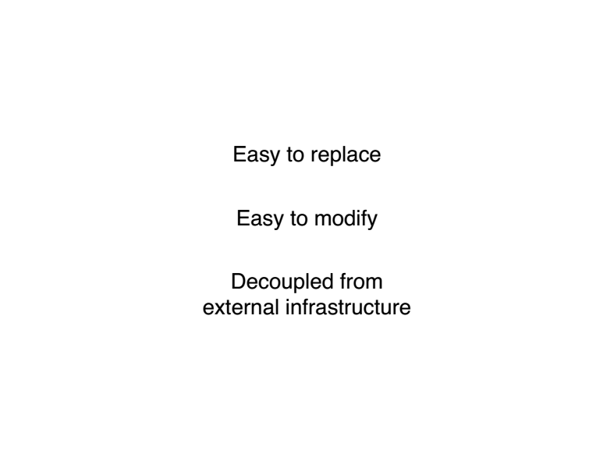

Slide 23
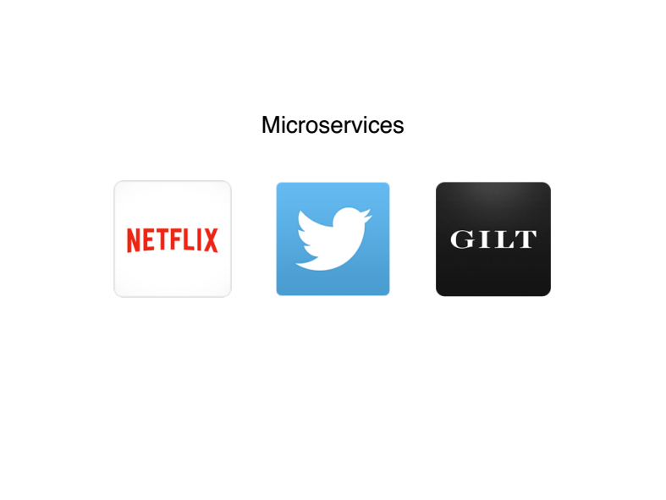

Slide 24
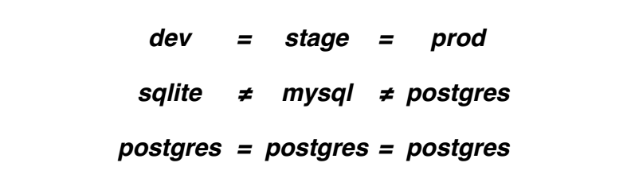
Dev/Prod Parity

Slide 25
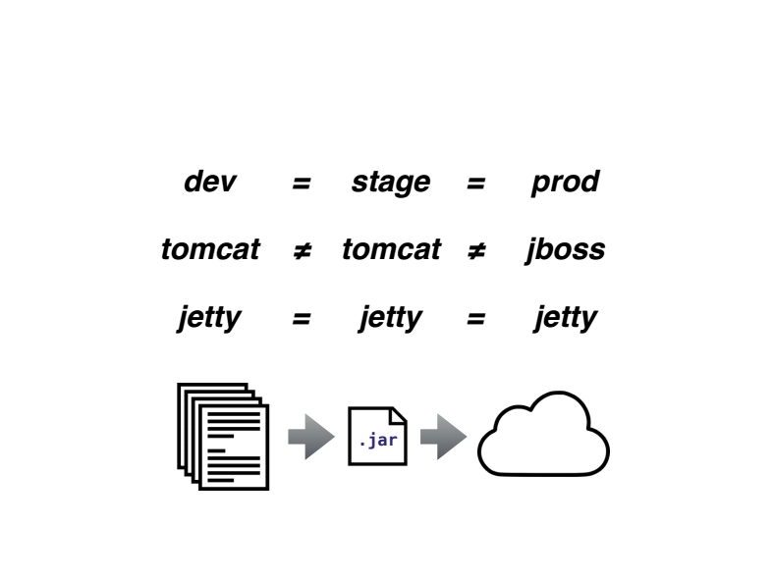

Slide 26
LOGS
Treat logs as event streams
Logs are the stream of aggregated, time-ordered events collected from the output streams of all running processes and backing services.
The event stream for an app can be routed to a file, or watched via realtime tail in a terminal. Most significantly, the stream can be sent to a log indexing and analysis system such as Splunk, or a general-purpose data warehousing system such as Hadoop/Hive.

Slide 27
ADMIN PROCESS
Run admin/management tasks as one-off processes
Execute migrations on deployement or startup.

Slide 28
Thanks a lot

